Slide 1
Brunswick landing
Building Maine’s Clean Tech Corridor
November 15, 2011

Slide 2
Brunswick Landing
Building Maine’s Clean Tech Corridor
Background
Concept and Vision
Role in Maine’s Clean Tech Corridor
Summary

Slide 3
Brunswick Landing Background
On August 22, 2005 the BRAC Commission voted to close Naval Air Station Brunswick
3,200 acre property
State-of-the-art facilities
Brunswick Landing
(former NAS Brunswick)

Slide 4
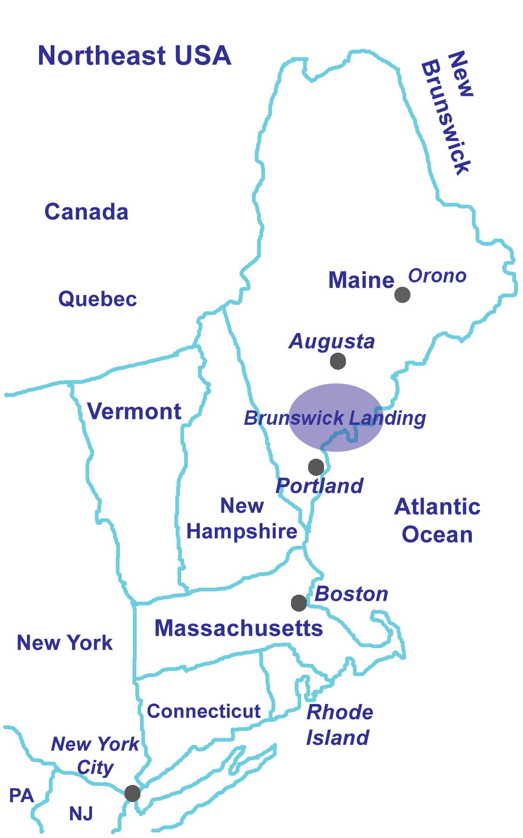
Brunswick Landing Background
Brunswick Landing is…
Located in Midcoast Maine
2 hours from Boston
30 minutes from Portland
2 hours from Orono (UMaine)
Within 20 miles of 1/3 of State’s population (414,530)
Easy access to I-295, I-95 and U.S. Route 1

Slide 5
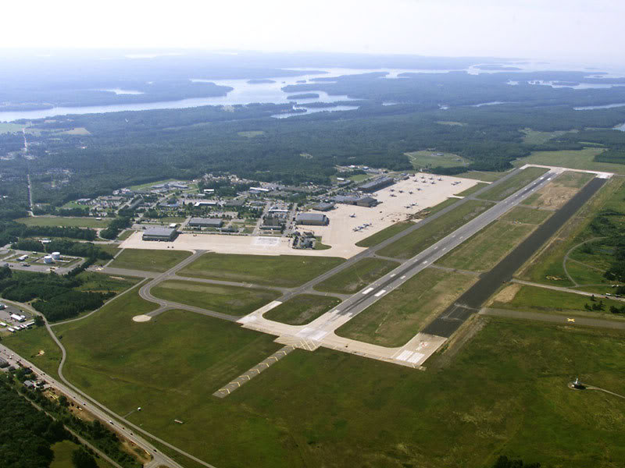
Brunswick Landing Background
World class aviation complex
Two 8,000 runways
Modern hangars and maintenance facilities

Slide 6
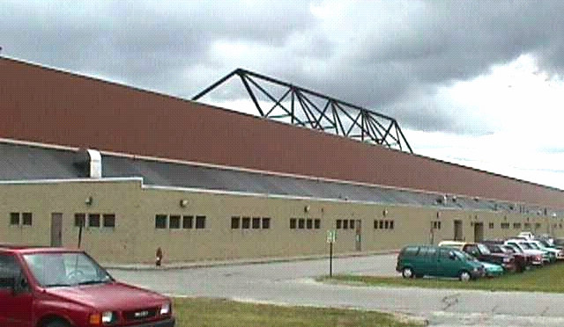
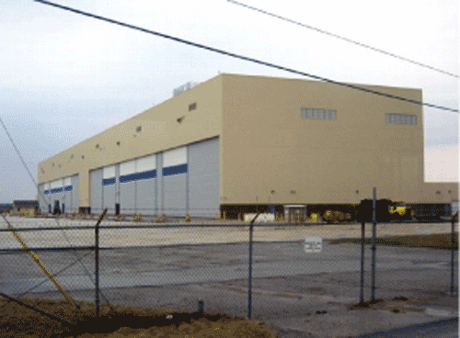
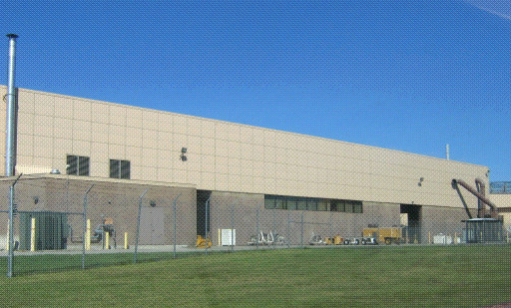
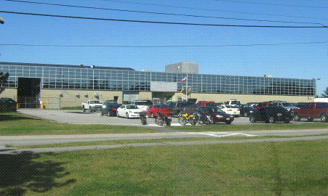
Brunswick Landing Background
Over 200 buildings totaling nearly 2 million square feet of commercial and industrial space (most less than 15 years old)

Slide 7
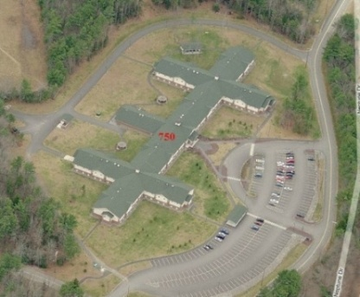
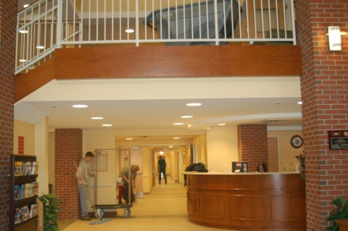
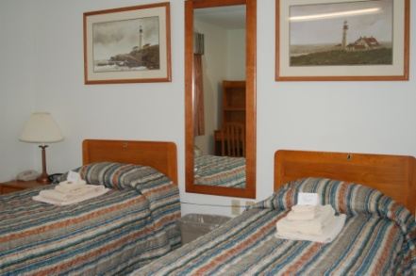
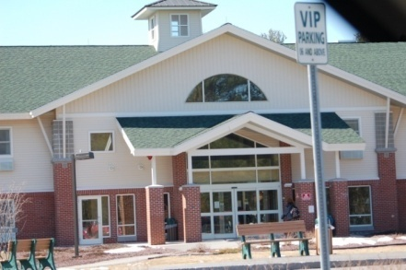
Brunswick Landing Background
Major IT assets including:
Single mode fiber optic network
Avaya Definity switch
Point of Presence for telephone switching
2nd largest hotel in Maine with 115,000 square feet and 250 rooms

Slide 8
Brunswick Landing Background
Midcoast Regional Redevelopment Authority (MRRA) is a non-profit, quasi-public organization established by Maine State Legislature to implement the Reuse Master Plan for NAS Brunswick

Slide 9
Brunswick Landing Background
Reuse Master Plan calls for centers of excellence in advanced technologies
Composites
IT
Aerospace
Renewable energy
Top notch educational facilities

Slide 10
Brunswick Landing Background
MRRA is committed to creation of:
Science and technology “smart” park
Center of excellence for clean technology innovation
Variety of corporate, business, and academic, services

Slide 11
Brunswick Landing Background
Targeted business sectors for redevelopment:
Aviation
Composite Materials
Information Technology
Education
Alternative Energy
Tourism

Slide 12
Brunswick Landing Background
Key components of MRRA’s redevelopment plan and business attraction efforts include:
Southern Maine Community College (SMCC) Midcoast Campus and associated Maine Advanced Technology Center (MATC)
Brunswick Renewable Energy Center (REC)

Slide 13
Brunswick Landing Background
Southern Maine Community College &
Maine Advanced Technology Center (MATC) provide:
Dedicated labs, classroom space, and application shops for manufacturing and composites training
Will train workers in skills required to succeed in high-growth, high-demand industries:
Advanced Manufacturing
Composites Training
MATC will drive the advancement of the manufacturing industry, and make Maine and Brunswick Landing an attractive place for companies looking to expand or relocate

Slide 14
Brunswick Landing Concept & Vision
Reuse Master Plan calls for:
Developing a renewable energy center at Brunswick Landing
Focusing on clean tech industries that have potential to put Brunswick Landing at epicenter of the emerging clean energy market

Slide 15
Brunswick Landing Concept & Vision
Maine is already building a
strong base of renewable energy businesses
The creation of a Renewable Energy Center will:
Establish and grow a new clean technology cluster around renewable energy
Develop and deploy lower cost , “green” energy sources for the property (competitive advantage) on our own “smart” microgrid

Slide 16
Brunswick Landing Background
The Renewable Energy Center is envisioned to be…
Center of Excellence for clean technology research, development and demonstration
World-renowned living laboratory for integrated R&D, manufacturing, and operation of “next generation” clean technologies

Slide 17
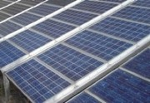
Brunswick Landing Summary
The Renewable Energy Center will be designed to:
Attract clean technology businesses
Make Brunswick a national center for clean technology
Create new and sustainable cleantech job opportunities

Slide 18
Brunswick Landing Summary
As it develops, the Renewable Energy Center will be poised to offer services that will complement and integrate with other services available through the New England Clean Tech Corridor

Slide 19
Contact
Tom Brubaker
Clean Technology Manager
Email: tomb@mrra.us
Dave Markovchick
Economic Development Manager
Email: davem@mrra.us
Midcoast Regional Redevelopment Authority
4 Admiral Fitch Avenue,
Brunswick, Maine 04011, USA
Phone +1 207 7986512
Fax +1 207 7986510
www.mrra.us

